Slide 1
Notes:
HTML5 Based Aria using REST
http://html5.us.oracle.com/aria/
For reference:
SQL Dev REST Definitions
http://krisrice.blogspot.com/2013/08/sql-developer-meets-rest.html
JQuery + REST
http://krisrice.blogspot.com/2013/07/using-rest-to-search-in-jquery.html
http://krisrice.blogspot.com/2013/07/combining-restful-jquery-and-knockoutjs.html
http://jsbin.com/efiqix/8/edit?html,output
Sessions
http://jsbin.com/sig/3
Waits
http://jsbin.com/paxoqihe/5
Cursor Support
http://krisrice.blogspot.com/2013/09/restful-cursor-support-for-json.html
HTML5 Chunked File loading
http://krisrice.blogspot.com/2013/08/chunked-file-loading-with-apex-listener.html
file:///Users/klrice/rmoug/fileload.html
Mapping headers
https://apex.oracle.com/pls/apex/dbtools/example/env
Collection Example:
http://jsbin.com/becinaheca/1/edit?
Real World Example:
http://krisrice.blogspot.com/2013/07/no-db-access-use-rest.html
NO SQL
http://localhost:8080/i/demofiles/index.html
RESTEasy
http://jsbin.com/sixafori
Meta Catalog
http://localhost:9999/ords/klrice/metadata-catalog/
EMP
http://localhost:9999/ords/klrice/objects/emp/
Filters
http://localhost:9999/ords/klrice/objects/emp/?q={%20%22ENAME%22:%20{%22$ne%22:%22SMITH%22}%20}
http://localhost:9999/ords/klrice/objects/emp/?q={%22ENAME%22:{%22$instr%22:%22SM%22}}
http://localhost:9999/ords/klrice/objects/emp/?q={%22$orderby%22:{%22ENAME%22:%22DES%22}}

Slide 2
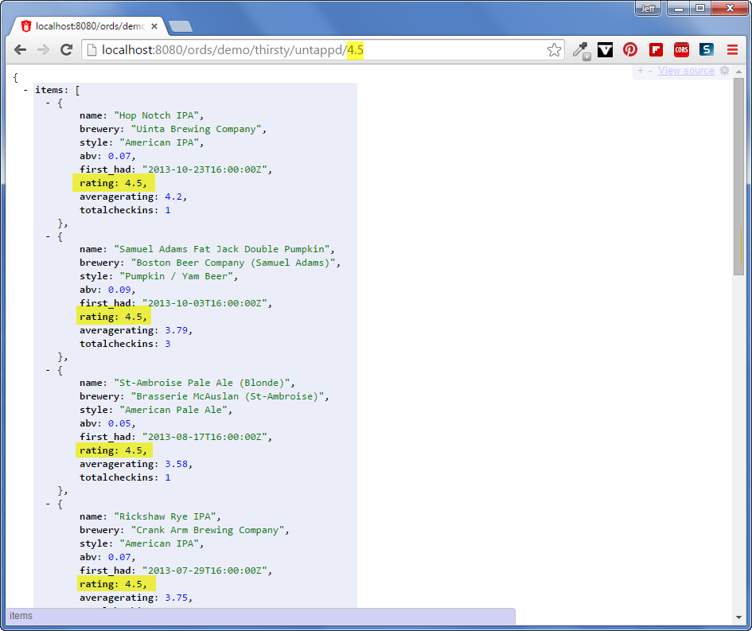

REST Enabling Oracle Tables with Oracle REST Data Services
AND ORACLE SQL DEVELOPER!!!
Jeff Smith
Jeff.D.Smith@oracle.com || @thatjeffsmith
Senior Principal Product Manager
Database Development Tools Group
Notes:
This is a Title Slide with Picture and Logo slide ideal for including a picture and partner or product logo with a brief title, subtitle and presenter information.
To customize this slide with your own picture:
Right-click the slide area and choose Format Background from the pop-up menu. From the Fill menu, click Picture and texture fill. Under Insert from: click File. Locate your new picture and click Insert.
To Replace the LOGO on this sample slide:
Right-click the sample LOGO and choose Change Picture. Navigate to the location where the new logo is stored, select desired logo file and click on the Open button to replace the sample logo.

Slide 3

Agenda
ORDS Overview
What is REST?
Installing ORDS from SQL Developer
Enabling REST Access for Tables
Defining RESTful Services from SQL Developer
Security

Slide 4



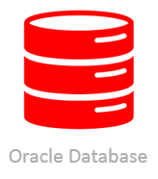
What is Oracle REST Data Services (ORDS) ?
Formerly known as Oracle APEX Listener

Slide 5
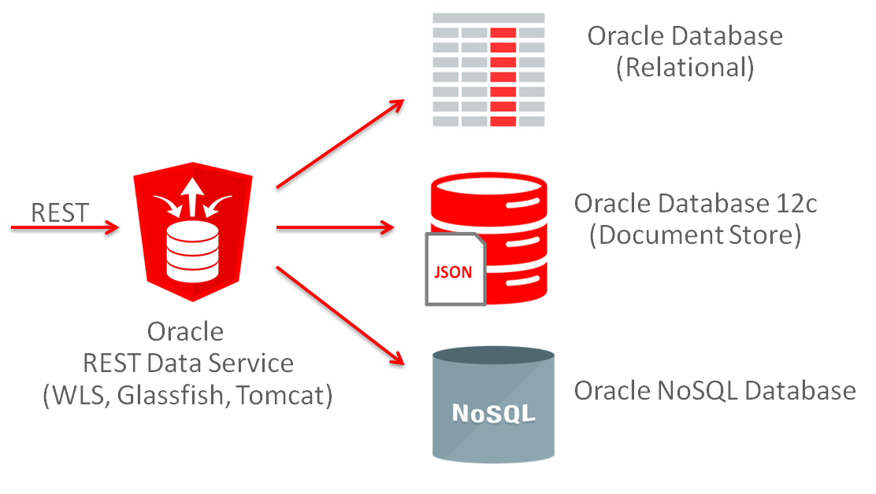
What is Oracle REST Data Services (ORDS) ?
REST Enable/API the Database!

Slide 6
REpresentational State Transfer (REST)
The Architectural Style of the Web
Model resources, not actions:
GET /ords/hr/employees/ - GOOD
GET /ords/hr/GetAllEmployees/ - BAD
Use nouns, not verbs
Uniform operations on all resources:
GET, POST, PUT, DELETE, OPTIONS, HEAD
Many nouns, just a few uniform verbs
Stateless requests, state transitions communicated via hyper-links.
IT'S ALL ABOUT THE HYPER-LINKS

Slide 7
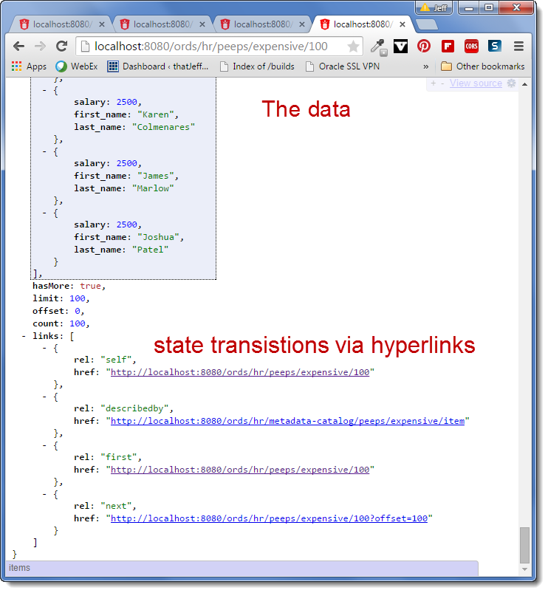
“It’s all about the hyperlinks…”
JSON output from a RESTful Service Powered by ORDS

Slide 8
The Verbs
Uniform Verbs for interacting with all resources
Method | Purpose | Classification | Database Operation
GET | Retrieve resource | Safe, Idempotent | Select
HEAD | Retrieve metadata | Safe, Idempotent | Select
OPTIONS | Methods supported by resource | Safe, Idempotent | N/A
PUT | Create or replace resource | Idempotent | Merge, Update
DELETE | Delete resource | Idempotent | Delete
POST | Anything. Normally create | Unsafe | Insert

Slide 9

Oracle REST Data Services
Introduction
Provides data access consistent with modern App Dev frameworks
Mid tier application
map standard http(s) RESTful gets and posts to SQL
declaratively returns results in JSON format
JavaScript friendly
supports high numbers of end users
Services
HTTP(s) relational data access
Oracle JSON collection based schema-less access
Oracle NoSQL access over HTTP
Oracle APEX mid-tier, web toolkit applications, mod_plsql replacement
Formally known as Oracle APEX Listener
Supported feature of the Oracle Database since 2010
Ships with Oracle Database 12.1.0.2
Notes:
Built in is glassfish grizzly
http://www.oracle.com/technetwork/issue-archive/2014/14-mar/o24adf-2147201.html

Slide 10
Oracle REST Data Services
Release History
Version | Date | Description
1.0 | 2010 | First release as Oracle APEX Listener with with support for OWA toolkit used by APEX
1.1 | 2011 | First release with REST support for JSON, Microdata, CSV, Pagination. Also added FOP
2.0 | 2012 | OAuth2 support, Integrated with APEX, Multi Database, SQL Developer integration
2.0.5 | 2013 | Added PDB support
2.0.6 | 2014 | Renamed to Oracle REST Data Services to emphasize REST commitment
2.0.8 | 2014 | Added REST Filtering
3.0 | 2015 | REST AutoTable, NoSQL, DB12 JSON, Bulk loading over REST,…

Slide 11


Oracle REST Data Services Serving JSON results from relational data
Oracle REST Data Services
URI
Map and Bind
SQL
JSON
Transform to JSON
Transform
SQL Result Set
HTTP(S) client
Oracle Database
Data stored in standard relational tables and columns
Oracle REST Data Services (ORDS) Developer defines URI<>SQL mapping
App Developer calls named URI over HTTP(S) gets and posts
Notes:
Client goes thru app mid tier (not shown)
Data stored in standard relational tables and columns
ORDS Developer defines SQL that satisfies named URI requests
App Developer calls named URI over http(s) gets and posts
ORDS maps URI to the SQL and performs data bindings
ORDS transforms the SQL result set to JSON

Slide 12



Oracle REST Data Services 3.0
RESTful access to relational data returned in JSON format
http://myhost/ords/human/peeps/10
2. ORDS maps to “EMPLOYEES” table
1. Browser RESTful get request
SELECT * FROM EMPLOYEEES
WHERE EMPLOYEE_ID = 10
Oracle REST Data Services
3. SQL Call over JDBC (via db connection pool)
5. JSON
4. DB returns JDBC Results
Browser
ORDS Runs in WLS, Tomcat, Glassfish container, or as a standalone process
Oracle DB
Automatic REST based CRUD API for tables, views, and coming soon, PL/SQL stored procedures
RESTful Services which can ran any SQL or PL/SQL block
Supports all of your favorite data types, including complex things like SDO_GEOMETRY
Notes:
New with REST Data services 3.0 it does not require APEX to define your REST Data services. Oracle currently distributes “Oracle APEX Listener”, which will be renamed to Oracle REST Data Services.
Delivered with Database 12.1.0.2
Java Based plugin replacement for Apache mod_plsql
Formally known as Oracle APEX listener available on OTN
Available today on our Database Cloud Schema Service

Slide 13
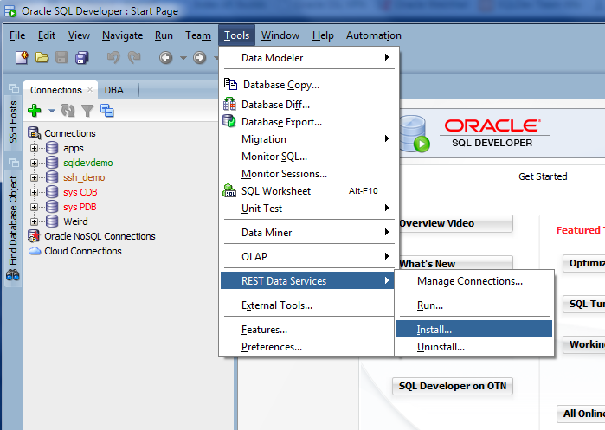
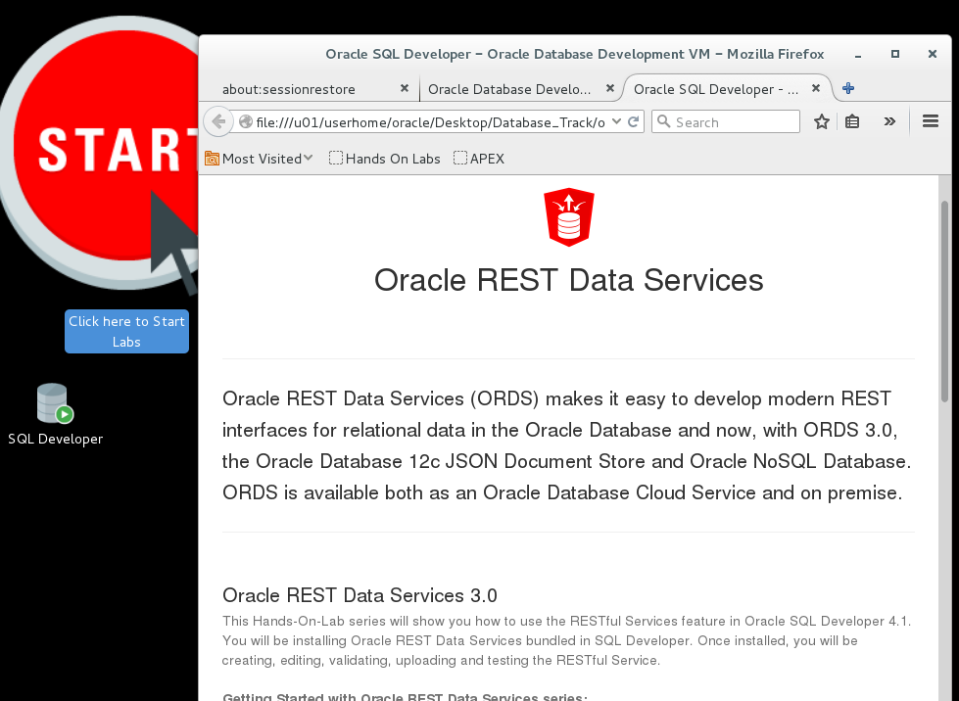
ORDS – How do I get started???
Use SQL Developer to install & run. Use Hands On Labs to learn.

Slide 14
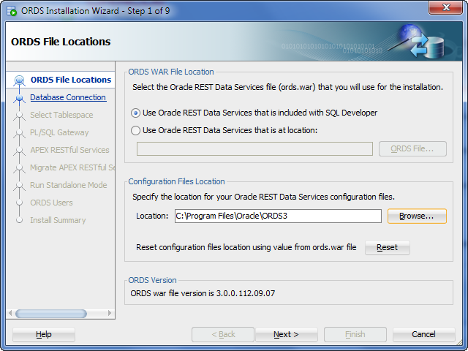
Install Embedded or
Install Download
Specify config DIR

Slide 15
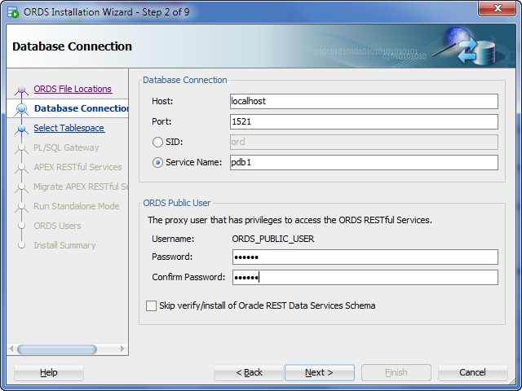
Config DB connection
ORDS supports multiple databases!

Slide 16
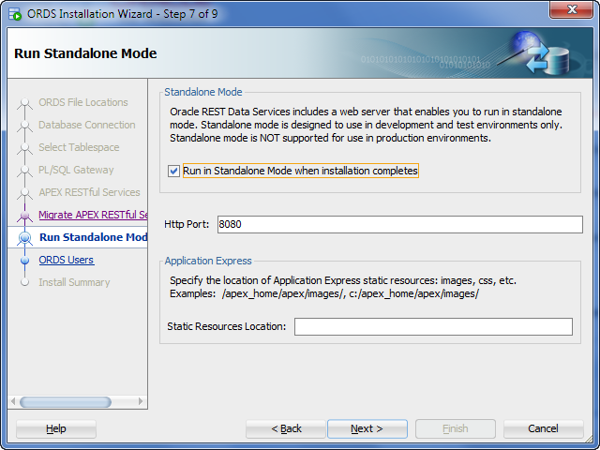
Standalone mode good for dev/test
ORDS includes HTTP Jetty Server
Specify PORT

Slide 17
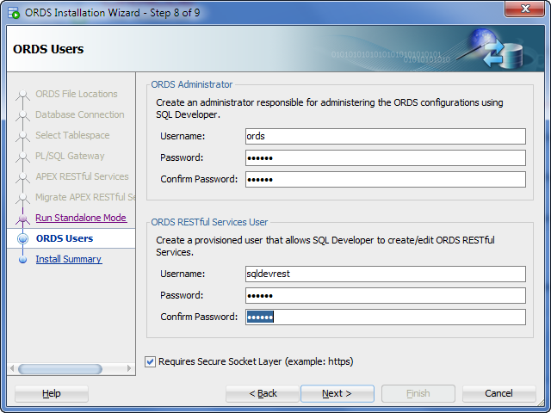
Create Users
Administrator
Developer
You can create users from command-line
Grant ORDS roles to your Mid-Tier users

Slide 18
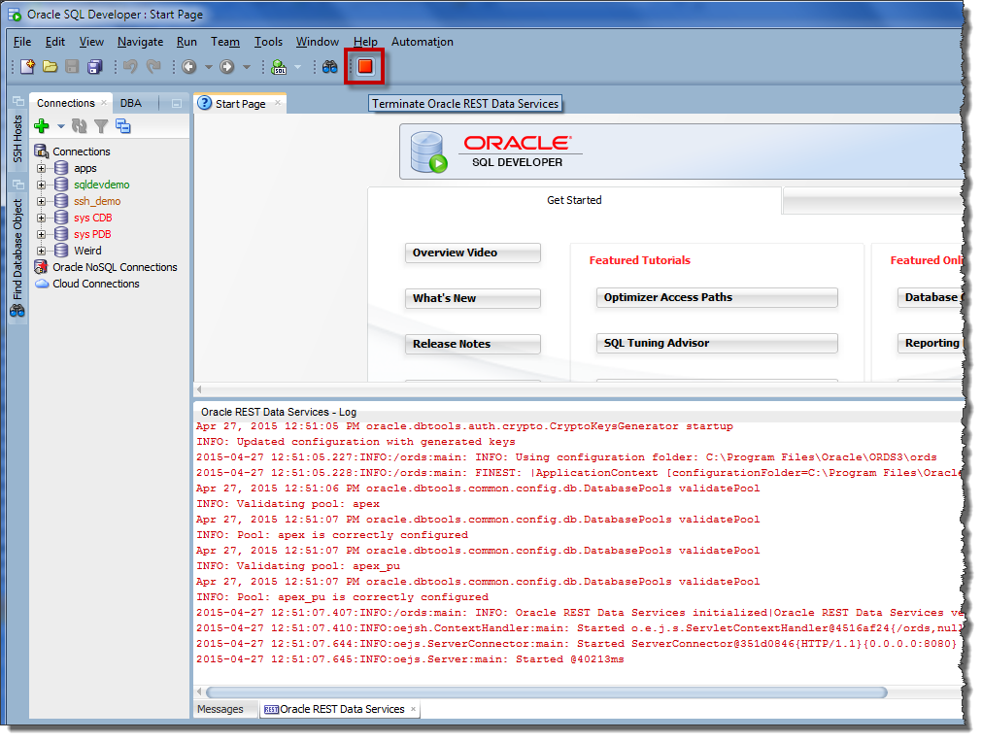
ORDS is now configured and running against my PDB
‘Standalone Mode’ – lacks convenience and power of Mid Tier Management
Run w/SQLDev
Easy
Push-Button
Deploy to Mid Tier servers when ready to go to Production

Slide 19
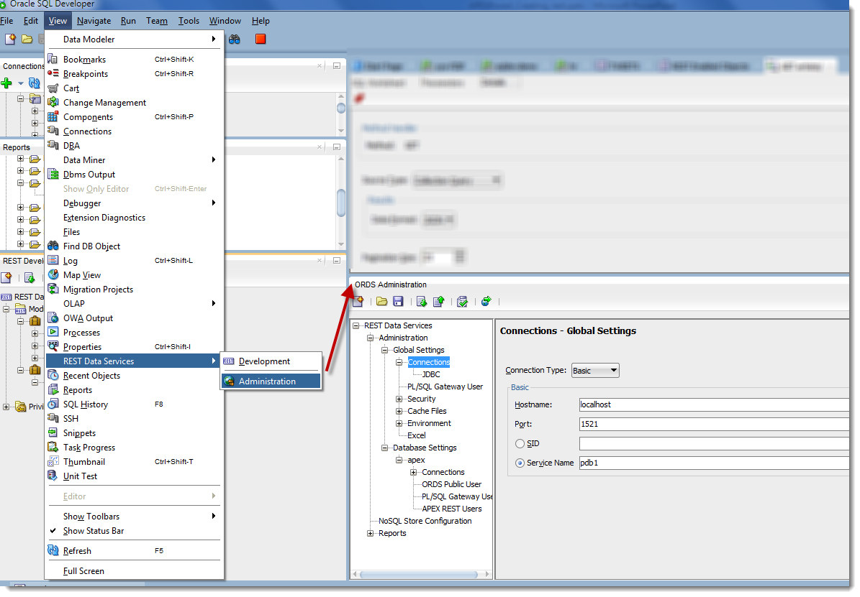
Admin ORDS From SQL Developer
Make changes via GUI vs XML…upload when ready

Slide 20
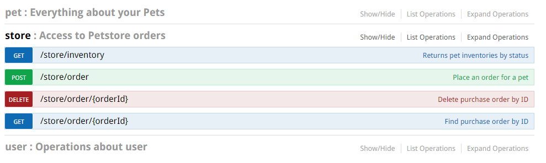
Auto REST for Tables and Views
Get Data In and Out – Just using REST – requires ORDS 3.0 and higher

Slide 21
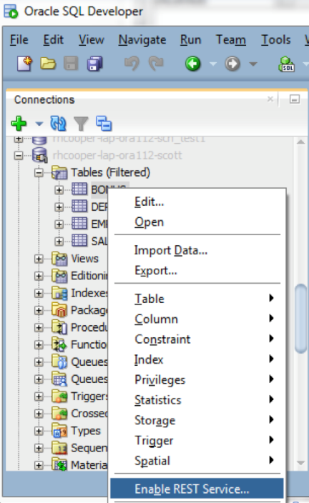
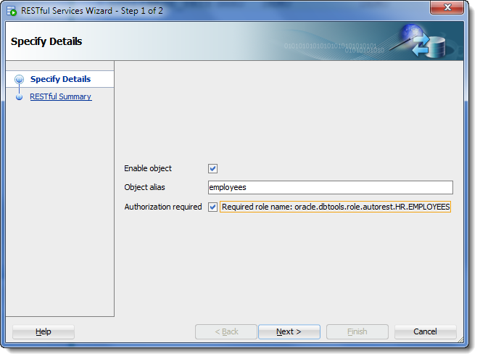
Oracle REST Data Services
Auto enablement of RESTful request modules – User Interface
Right click to Enable REST Service
Set Properties: on or off, alias?, require authorization?

Slide 22
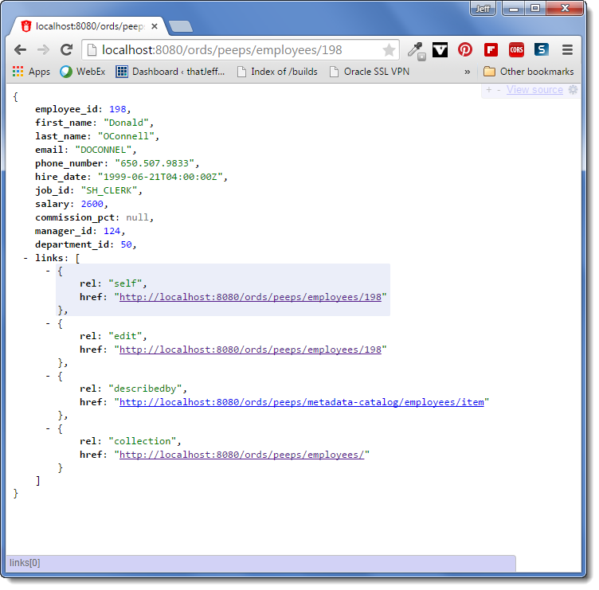
http://localhost:8080/ords/peeps/employees/198 I aliased HR as ‘peeps’ … automatically pull up a record via the PK, EMPLOYEE_ID

Slide 23
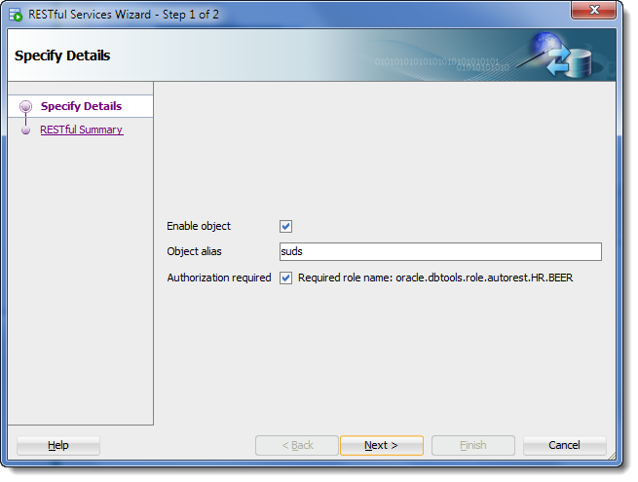
REST, CRUD Table API
Auto enablement of RESTful request modules – User Interface
Exposes these operations
Schema level Metadata
Table Metadata
Get ( Select )
Query ( Filtering )
Insert
Update
Delete
Bulk load
Right click to Enable REST Service

Slide 24
Filtering
Developer can now offload filtering REST requests on the SERVER via SQL
Operators
$eq,$gt,$lt,$lte,$gte,$ne,$instr
Logical
$and, $or
Time Based ( coming in 3.0 )
$asof
Examples:
{ "qty": { "$gt": 20 } }
{"$and": [{"price": {"$ne": 1.99}},{"price": {"$notnull": ""}}]
{"price": [{"$ne": 1.99}},{"$notnull": ""}]
{"$or": [{"qty": {"$lt": 20}},{"sale": {"$eq": "TRUE"}}]
$asof: {"$timestamp": ”……"}

Slide 25
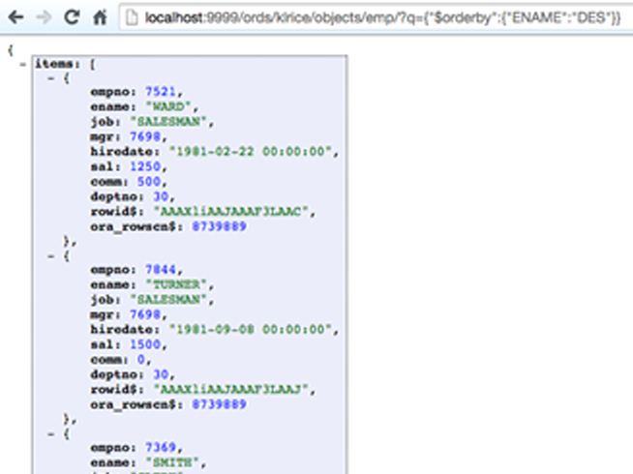
Filtering - Examples
URI Escape the filter
Add as ?q=JSON
Notes:
http://localhost:9999/ords/klrice/objects/emp/?q={%20%22ENAME%22:%20{%22$ne%22:%22SMITH%22}%20}
http://localhost:9999/ords/klrice/objects/emp/?q={%22ENAME%22:{%22$instr%22:%22SM%22}}
http://localhost:9999/ords/klrice/objects/emp/?q={%22$orderby%22:{%22ENAME%22:%22DES%22}}

Slide 26
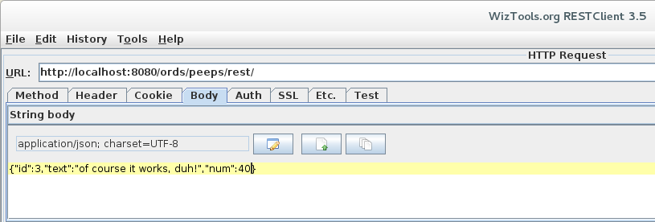
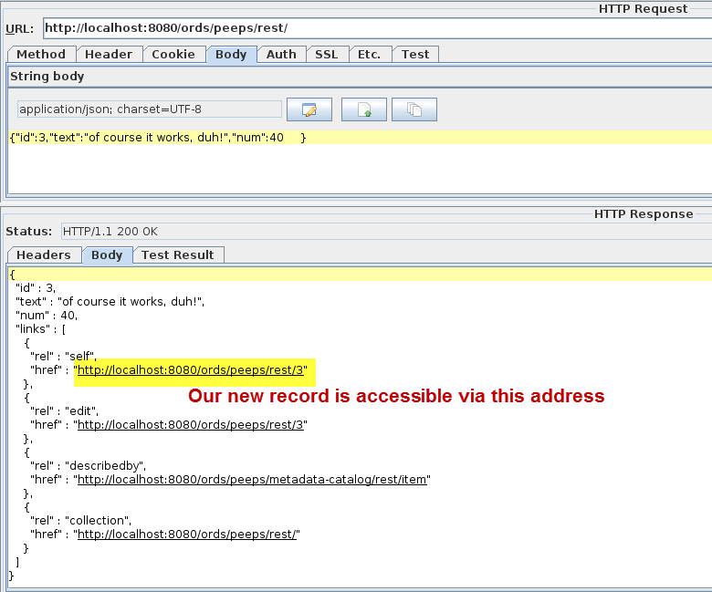
POST: Insert a New Record

Slide 27
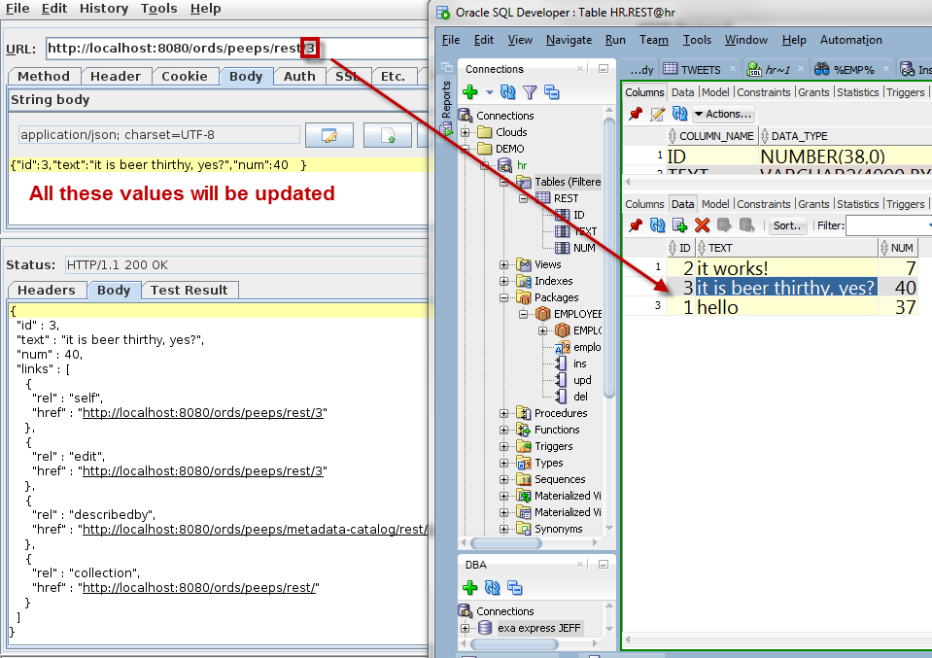
PUT: Update an Existing Record

Slide 28
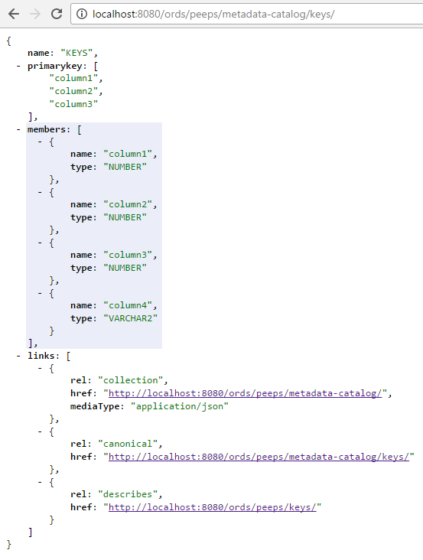
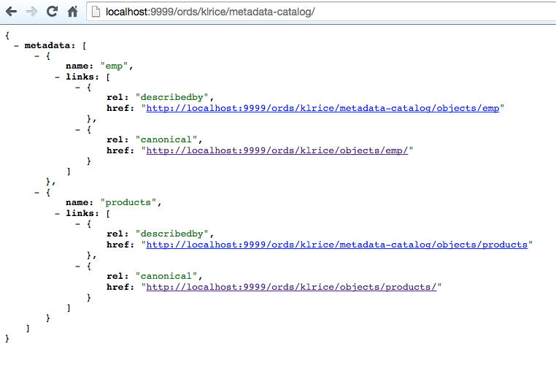
Metadata Catalog
Show me what’s available for SCHEMA or DESC a RESOURCE (Table/View)
Catalog of all REST enabled Objects
/ords/<schema>/metadata-catalog/
Notes:
http://localhost:9999/ords/klrice/objects/emp/?q={%20%22ENAME%22:%20{%22$ne%22:%22SMITH%22}%20}
http://localhost:9999/ords/klrice/objects/emp/?q={%22ENAME%22:{%22$instr%22:%22SM%22}}
http://localhost:9999/ords/klrice/objects/emp/?q={%22$orderby%22:{%22ENAME%22:%22DES%22}}

Slide 29
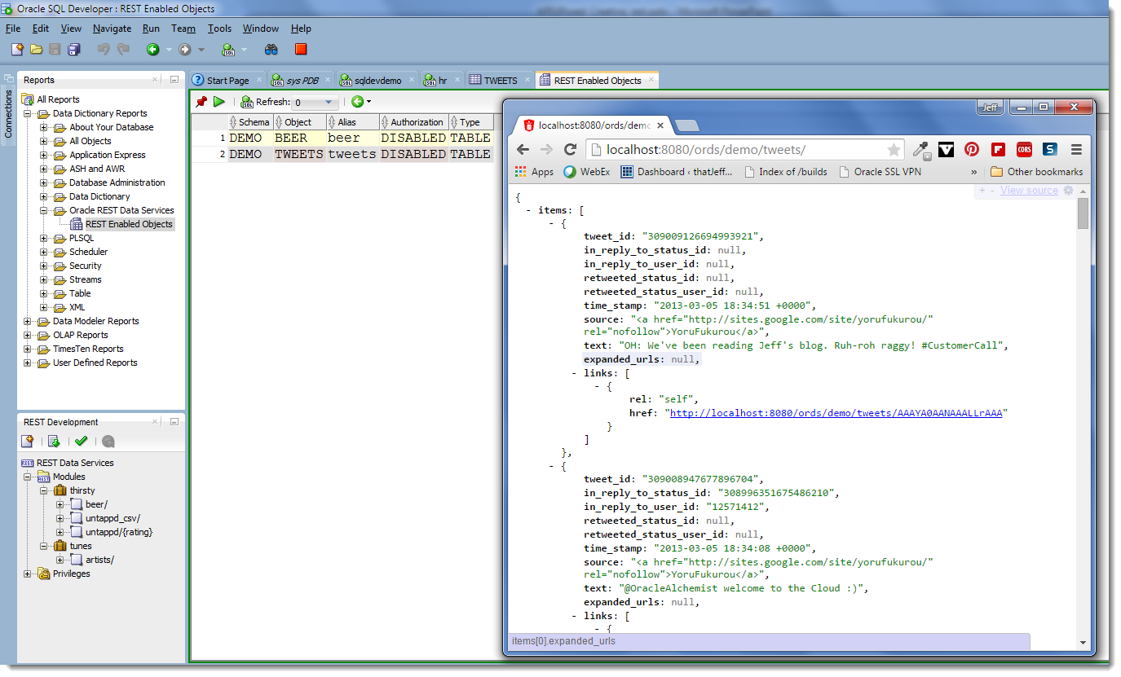
REST Services Report
In SQL Developer – Shows ‘auto’ REST enabled objects for current schema

Slide 30
Oracle REST Data Services: RESTful Services
When AUTO is Not Enough
http://myhost/myapplication/custorders/simplequery { custno: 1001}
Map URI request to data access template
Bind custno (1001) to bindcustno
Execute select statement below
Note embedded cursor expression
Set format to JSON
{ “custno”: 1001,
“name”: “Scott King”,
“address”: “500 Oracle Parkway, Redwood Shores, CA, 94065”,
“country”: “USA”,
“class”: “A”,
“orders”: [ { “orderno”: 303,
“orderdate”: “Feb 26, 2014”,
“status”: “in process”},
{ “orderno”: 202,
“orderdate”: “Jan 16, 2014”,
“status”: “processed”},
{ “orderno”: 101,
“orderdate”: “Dec 2, 2013”,
“status”: “processed”} ] }
select c.*,
cursor(
select *
from orders o
where o.custno = c.custno)
orders
from customers c
where c.custno = :bindcustno
Data Access Template
JSON Result

Slide 31
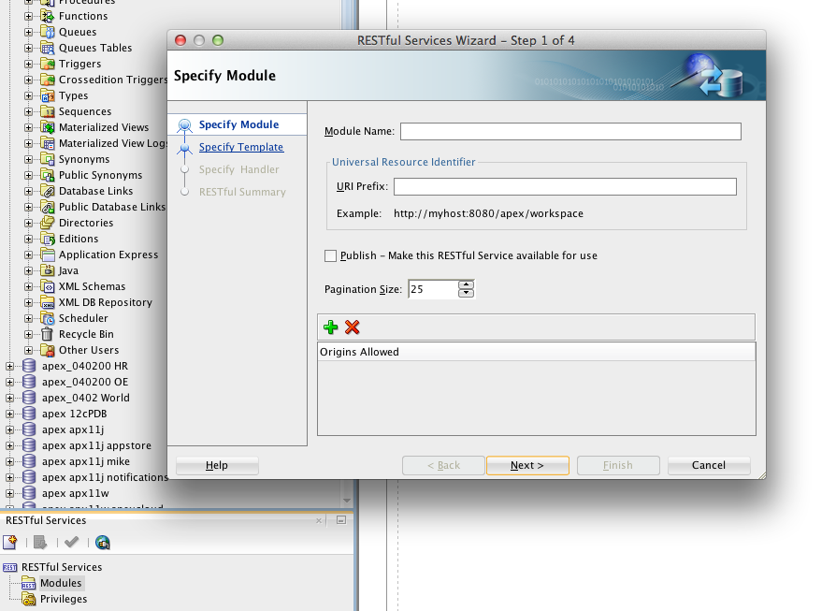
Oracle SQL Developer Support for ORDS
RESTful Services – build, test, deploy
SQL Developer, 5M users
Install & Run ORDS from SQL Developer
Type SQL, Test SQL, Publish
Notes:
31

Slide 32
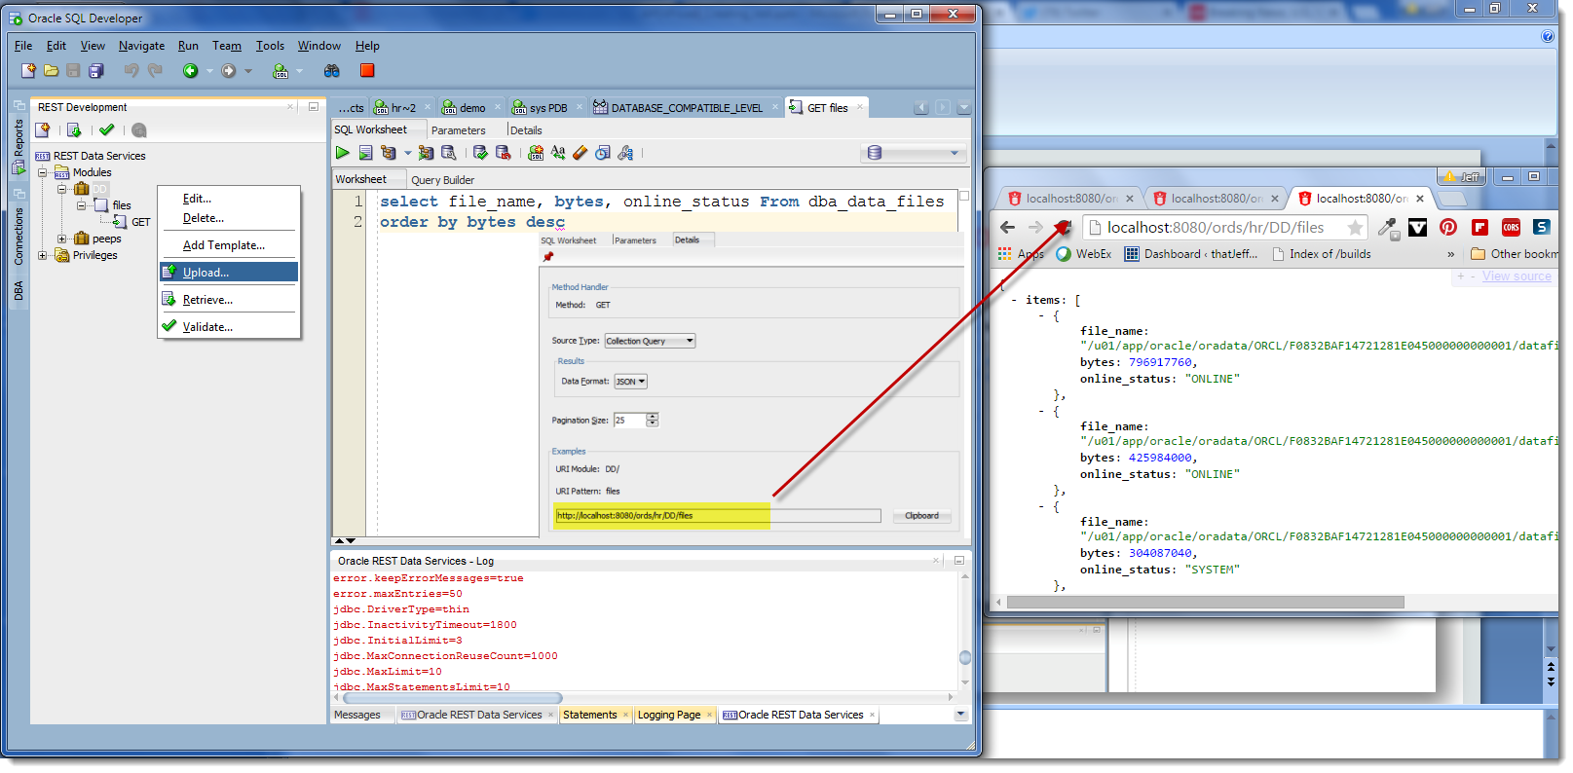

Slide 33
GUI too fat for you? We have PL/SQL APIS too!
Full set of PL/SQL APIS to define REST (Oracle Docs)
Scriptable , Repeatable
begin
ords.create_service(
p_module_name => 'examples.employees' ,
p_base_path => '/examples/employees/',
p_pattern => '.' ,
p_items_per_page => 7,
p_source => 'select * from emp order by empno desc');
commit;
end;

Slide 34
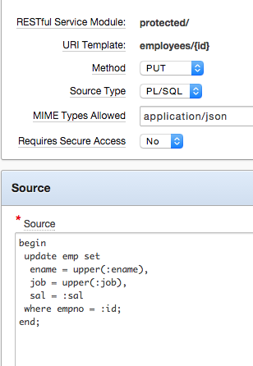
Value Passing – Body
Mime type of application/json
Converts json names into binds
{“ename”:”Kris”,
”job”:”janitor”,
”sal”:123}

Slide 35
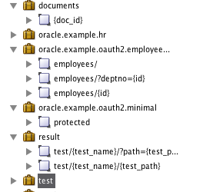
Value Passing – URI
Uses { } to denote portions of the URI
Available for sql or pl/sql
Implicit bind conversion

Slide 36
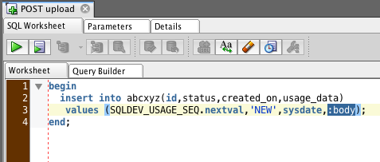
Value Passing – LOB/Binary Data
Implicit bind named “body”

Slide 37
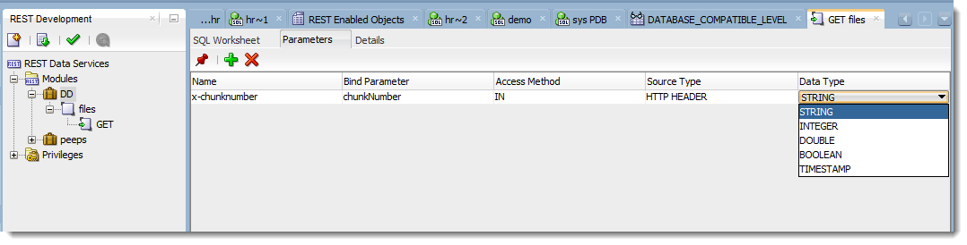
Value Passing – Headers, defining in SQL Developer
Parameters
Access any http header as a bind
Map headers or URI
Also outbound headers
Notes:
http://jsbin.com/ObuM/1/edit?html,output

Slide 38
OK, this JSON/REST stuff looks cool, but how does the app use it?

Slide 39
Oracle REST Data Services
Making a REST call…
JavaScript
Java
var xhr = new XMLHttpRequest(); xhr.onreadystatechange = function() {
if (xhr.readyState == 4) {
var data = xhr.responseText;
doSomething(data);
}
} xhr.open('GET', 'https://myhost/myapp/customerorders/1001’, true); xhr.send(null);
DefaultHttpClient httpClient = new DefaultHttpClient(); HttpGet getRequest = new HttpGet("https://myhost/myapp/customerorders/1001"); HttpResponse response = httpClient.execute(getRequest);
BufferedReader br =
new BufferedReader(
new InputStreamReader((
response.getEntity().getContent())));
JQuery
$.getJSON( "https://myhost/myapp/customerorders/1001", function( data ) {
doSomething(data);
});

Slide 40
Oracle REST Data Services
More Client Access Syntax Examples
Python
PHP
import json
import requests
url = 'http://whatever/service'
response = requests.get(url)
data = response.json()
print data
<?php
$url = 'http://whatever/service';
$response = file_get_contents($url);
$data = json_decode($response);
var_dump($data);
?>
Ruby
require 'json'
require 'net/http’
url = 'http://whatever/service'
response = Net::HTTP.get_response(URI.parse(url))
data = JSON.parse(response.body)
print data

Slide 41

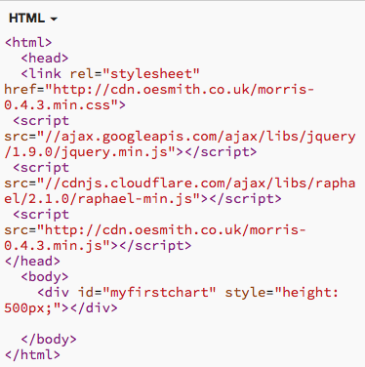
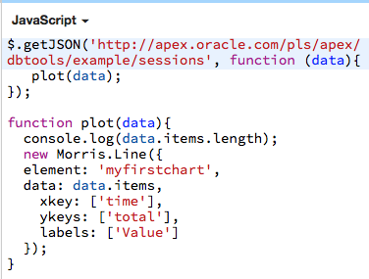
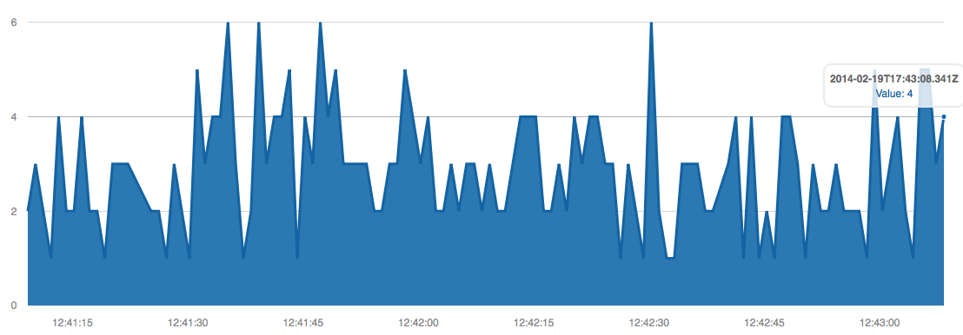
Oracle REST Data Services: I have the data, now what?
JavaScript HTML5 chart displaying DB sessions from Browser
Static HTML and JavaScript
“sessions” web service SQL defined in ORDS Repository
select max(sample_time) over
( partition by sample_id ) time,
count(1) over ( partition by sample_id ) total
from v$active_session_history
where sample_time > sysdate -1/96
Browser Results
HTML5 chart with minimal HTML and JavaScript (full syntax is on slide)
An ORDS repository defines the SQL to URI (request) mapping

Slide 42
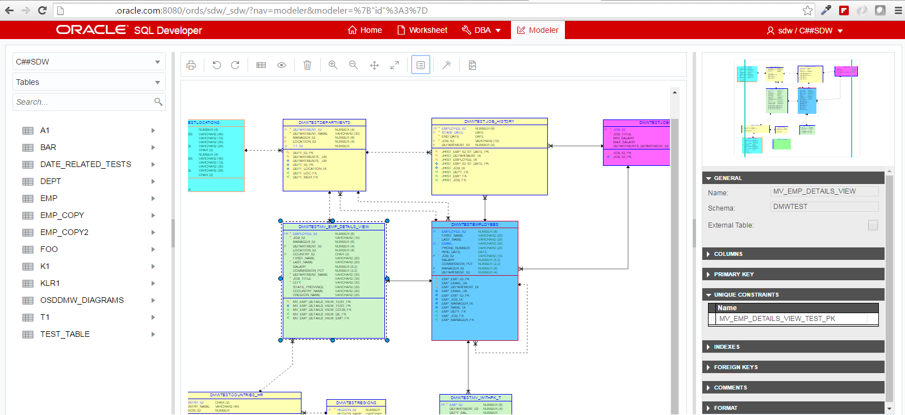
SQL Dev Web = ORDS, REST, HTML5, JS (Oracle Jet)

Slide 43
Don’t Forget Security!
Any standard mechanism for securing URLs
Oracle Identity Management
Webgate is installed at the webserver and configured to protect URIs
WebGate will redirect to SSO for sign on and allow follow on requests
Database Authentication
1st Party Authentication

Slide 44
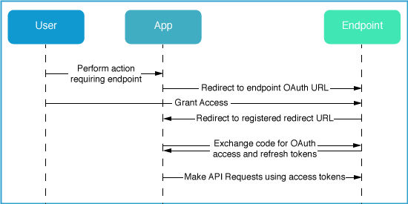
Security
OAuth2 Server Built in
Works with Webserver’s configuration for Authentication

Slide 45
Insert Live Demo Here ☺
Demo
Questions?
Resources
Developer Day VM (everything running PLUS hands on labs)
Download ORDS
Download SQL Developer
ORDS Development Guide (DOCS)
Why Use REST Blog Post
Notes:
﻿http://slc06cql.us.oracle.com/dbaas_monitor_demo/#/

